Slide 1




Integrated Program in Business Analytics
Part of
Pricing Analytics in Hospitality Industry
Batch -C
Group – 7A

Slide 2
Agenda
Business Problem and Objectives
Executive Summary
Data Overview and Key Business Assumptions (if any)
Data Preparation and Pre-processing
Sanity checks, treatment and transformations for analytical dataset preparation
Exploratory Data Analysis
Key Business Findings and Insights
Model Development and Validations
Model comparisons on key scoring metrics and model finalization
Dashboard (required only when it is in scope of analysis)
Businesss Recommendations and Potential Business Impact
Appendix

Slide 3

Business Problem and Objective
In the heart of Chennai, stand 2 hotels with 330 rooms and 6 restaurants in their portfolio. Efforts are underway, to bring data together in ways not previously explored with a focus on enabling analytics across the enterprise, thanks to COVID -19.
Dynamic pricing in hotels is a strategy used to improve revenue and ensure maximum occupancy for the hotel. The task is to optimize dynamic pricing of Room Rates of one of the Hotels “Raintree – Anna Salai”. The hotel has 200 rooms with 3 restaurants.
Using Data Analytics and Machine learning to predict the optimal room rate to maximize revenue
Tracking real-time data and analyse booking patterns that shows the demand trends (Dashboarding)

Slide 4
Executive Summary
Reservation details for Fiscal year 2018 and 2019 were shared by the company included 10 feature columns
Linear Regression Model was used to predict the pricing. RMSE for the fitted model was around 17% and R Squared for the said model was around 14%
Random Forest and Decision Tree models were explored and scores were not satisfactory
Analysis highlighted that, Studio rooms had lower realisation than club rooms, even though, Studio rooms are considered to be higher end
Dashboarding to track real-time data was prepared in Power BI

Slide 5
Data overview
We were provided with daily reservation data. The task is to forecast the Room Rates.
Data fields | Details
Name | Name of the guest
Reservation No | Reservation No are automatically generated by ERP and unique to each reservation
Room Type | Room type for each reservation. Room rates vary depending upon room type
Arrival Date | Date of customer arrival
Departure Date | Date of customer departure
Adults/ Children | No of adults and children for whom the room has been booked
Nation | Nationality of the guest
Source | Source using which reservation was made
Room Rate | Rate agreed for the said reservation
Reservation Date | Date of reservation

Slide 6

Data preparation and Pre-processing
Fourteen levels of room types were defined in the ERP for room allocation and booking. However, for the purpose of analysis, the room types were grouped considering same room pricing. The same is as follows:
Guests from 118 countries stayed in the hotel during the Fiscal years 2018 and 2019. Excepting India, every nation was grouped into continents and analysis were performed continent wise
Grouped Category | As per Dataset
DELUXE | COR1
 | DHT
 | DQB
 | DTW
 | GRP
 | LSGE
 | PRM
SUITE | EXS
 | PRS
 | PSUT
 | SUT
STUDIO | STU
CLUB ROOM | CLB
Continent | No of Countries
Africa | 18
Asia | 41
Australia | 4
Europe | 33
North America | 10
South America | 10
United Nations | 1

Slide 7
EDA – Key Business Findings and Insights
No of bookings from each source
Average Room rate realised per room
Q1 & Q4 generally have higher reservations than Q2 & Q3
Source | No of Reservations
Company Sales Team | 37,908
Online Aggregators | 32,220
Travel Agency – USA | 5,188
Travel Agency – Europe | 1,674
Others | 14,261
Room Type | Avg Room Rate (INR)
Deluxe | 4,945
Club Room | 5,430
Studio | 4,846
Suite | 8,192

Slide 8
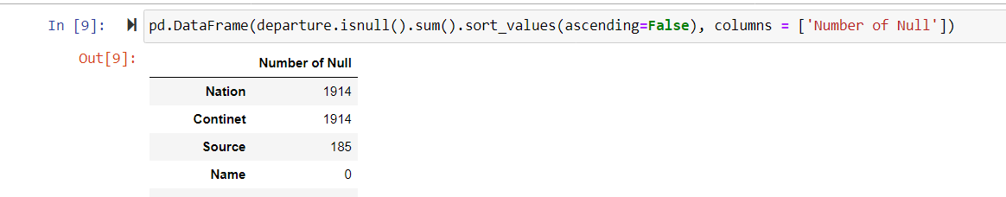
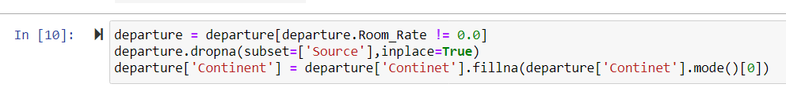
EDA – Missing Value treatment
Three variables had missing values
Null values in Source were dropped
Null Values in Continents were replaced with India as most of guests were from India
Room rates equal to “0” were dropped

Slide 9
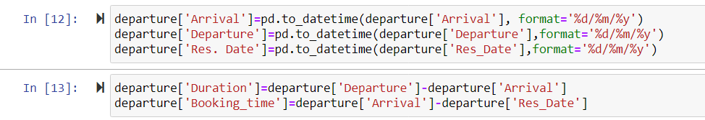
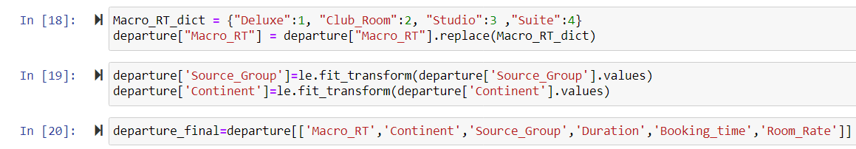
EDA – Creation of additional columns
Creation of new feature “Duration” to ascertain the Length of Stay
Room type is a categorical variable and room rate varies depending upon type of room. Encoding was done for Room type, Source and Continent as they were not numerical

Slide 10
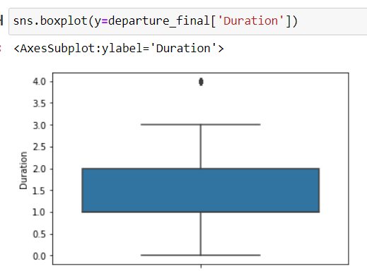
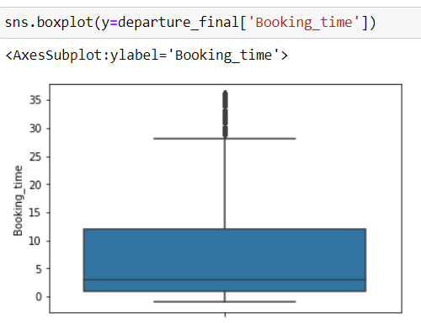

EDA – Outlier Treatment
Outliers in the dataset were identified and replaced
Outliers in Duration and Booking time were replaced with 4 days and 36 days respectively
Log transformation of Room Rates to make it normally distributed

Slide 11
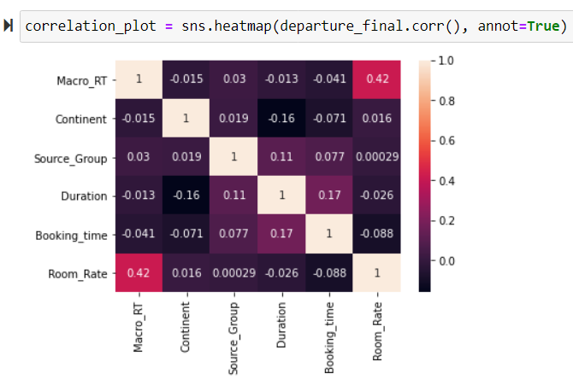
EDA – Correlation

Slide 12
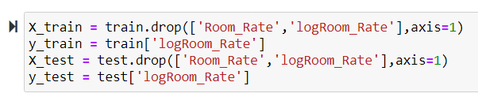

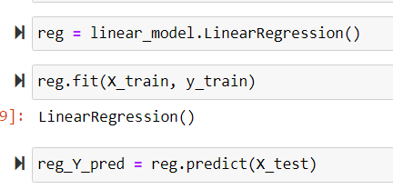
Model Development – Test and Train Data split
Splitting of training and test data
Fitting of linear regression model
Model Development – Linear Regression Model

Slide 13
Model Development – Model Finalisation and Key Scoring Metrics
RMSE for the fitted model is 17.90%
R Squared for the fitted model is 14.17%
Following steps were performed to improve R- Squared
Cross Validation of data using K-Fold and no change in R-Squared was noted
LASSO regularisation was applied to improve goodness of fit and no change in R-Squared was noted
We explored the possibility of identifying new independent variables and relevant data could not be obtained within the defined timeframe
To obtain better accuracy, following models were explored
In Decision Tree model, the RMSE was around 955. To obtain this score, we performed hyper parameter tuning using grid search to determine optimum parameters
In Random Forest model, the OOB score was 0.39 after optimizing estimators

Slide 14
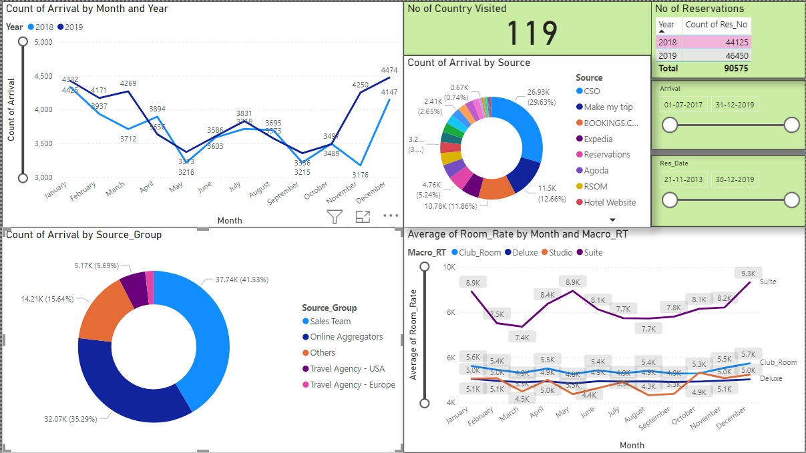
Dashboard

Slide 15
Business Recommendations
Summary of the average revenue per room per night realized from different sources
As informed by the company, Studio rooms belong to a higher category room than club room and deluxe. However, Average realization from Club Rooms and deluxe are higher than the studio rooms.
Company may explore the option to improve the room rates realized from studio rooms to increase the revenue
Lapses in data capturing in fields such as No of Adults/ Children, Nationality shall be improved which aids in better analysis
Particulars | Deluxe (INR) | Club_Room (INR) | Studio (INR) | Suite (INR)
Online Aggregators | 4,825 | 5,552 | 5,419 | 8,316
Others | 4,960 | 5,096 | 4,845 | 6,655
Sales Team | 5,128 | 5,505 | 4,717 | 8,443
Travel Agency – Europe | 4,834 | 5,345 | 5,716 | 6,768
Travel Agency - USA | 4,355 | 4,853 | 4,688 | 7,651

Slide 16
Thank You

